Slide 1
PHP in depth 5
3870

Slide 2
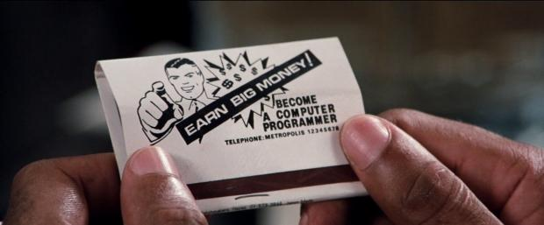
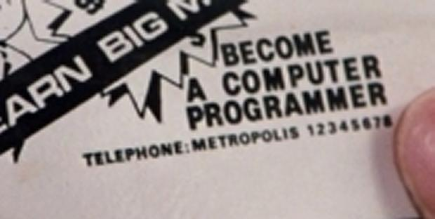
Notes:
http://www.denofgeek.com/movies/superman-iii/27817/what-superman-3-teaches-us-about-computer-programming

Slide 3

PHP Book
Programming PHP
Book
http://www.amazon.com/Programming-PHP-Kevin-Tatroe/dp/1449392776/
E-Book (free)
http://www.amazon.com/OneForMe-Learn-PHP-Programming/dp/B00984SFZG/

Slide 4
File Handling Functions
file_get_contents($filename)
returns the text of a given file as a string
file_put_contents($filename,$str)
writes text into a file, replacing any prior contents
file($filename)
returns the lines of a given file as an array of strings

Slide 5
More File Handling Functions
scandir($dir)
returns names of files in a directory as an array of strings
glob("*.txt")
returns names of files in a directory as an array of strings
file_exists, filesize, filemtime, fileperms, is_dir, is_readable, is_writable, disk_free_space, copy, rename, unlink, chmod, chgrp, chown, mkdir, rmdir

Slide 6
Example
// reverse order of the lines in the file with
// the given name
function reverse_lines($filename) {
$text = file_get_contents($filenmae);
$lines = explode("\n", $text);
$lines = array_reverse($lines);
$text = implode("\n", $lines);
file_put_contents($filename, $text);
}

Slide 7
Example 2
function reverse_lines($filename) {
$lines = file($filename);
$lines = array_reverse($lines);
file_put_contents($filename, implode("",$lines));
}

Slide 8
Exercise
Open a text file and count how many times each word appears in the file. Print out the result.
Test your results with PHPUnit.

Slide 9
GD(gif draw) library
Used to create images (jpegs, pngs, etc) using PHP (ex. dynamic calendar)
Used to create watermarks
Should come installed with WAMP but check it with phpinfo()

Slide 10
Simple Square
header('content-type: image/png');
//create an image stream of width and height
$image = imagecreate(300, 300);
//use rgb values to create color
$green = imagecolorallocate($image, 0, 255, 0);
//save the image as a png and output
imagepng($image);
//Clear up memory used
imagedestroy($image);

Slide 11
imagefilledrectangle
//try this
$green = imagecolorallocate($image, 0, 255, 0);
$red = imagecolorallocate($image,255,0,0);
//point one and then point two
imagefilledrectangle($image, 0, 0, 150, 300, $red);

Slide 12
imagefilledellipse
$green= imagecolorallocate($image, 0, 255, 0);
$red = imagecolorallocate($image,255,0,0);
$purple = imagecolorallocate($image,155,155,155);
// center and width, height
imagefilledellipse($image,150,150,100,100,$purple);

Slide 13
Exercise
Figure out how "imageline" works and draw a flag of France.
Draw a more complex flag if you finish early.

Slide 14
imagettftext
$image = imagecreate(300, 300);
$green = imagecolorallocate($image, 0,255,0);
$white = imagecolorallocate($image, 255, 255, 255);
//Set the path to our true type font
$font_path = 'C:\Windows\Fonts\Arial.ttf';
//Set our text string
$string = 'Hello World!';
//font size, angle, start point
imagettftext($image, 15, 0, 10, 160, $white, $font_path, $string);

Slide 15
imagecreatefromjpeg/png
header('Content-Type: image/jpeg');
$image =
imagecreatefromjpeg("hamburger.jpg");
imagejpeg($image);
imagedestroy($image);

Slide 16
Exercise
Create a meme generator where the user is able to pick string a message to a pre-existing image.

Slide 17
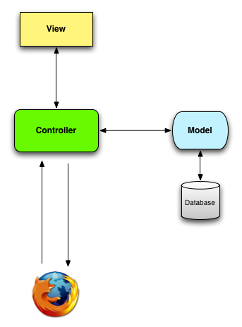
MVC architectural pattern

Slide 18
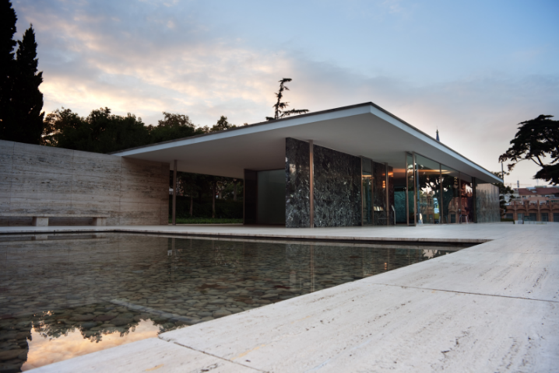
Architecture is the will of the epoch translated into space
- Mies van der Rohe

Slide 19
to be continued…

